Slide 1

Software Quality Engineering
BSSE-VI
Sumaira Nazir
Assistant Professor
Department of Software Engineering
National University of Modern Languages, Islamabad

Slide 2
Topics
Software Testing

Slide 3
Introduction
In the past, testing (other than some unit testing) was undertaken as the last part of development after the entire application was developed and documented.
Later, when problems were discovered too late, unit testing and integration testing became in vogue.
Major emphases on increased testing has met resistance
We cannot test everything!!!
We often ‘test’ documentation via standard SQA. But this does not test the functionality of the code.

Slide 4
Introduction…
Testing has become a huge business and major emphasis in software engineering!
Testing has been described as the process of executing a program with the intention of finding errors.
Testing = process of searching for software errors

Slide 5
Software Testing - Definition
Software testing is a formal process carried out by a specialized testing team in which a software unit, several integrated software units or an entire software package are examined by running the programs on a computer. All the associated tests are performed according to approved test procedures on approved test cases.

Slide 6
Software Testing Objectives
Direct objectives
To identify and reveal as many errors as possible in the tested software.
To bring the tested software, after correction of the identified errors and retesting, to an acceptable level of quality.
To perform the required tests efficiently and effectively, within the budgetary and scheduling limits.
Indirect objectives
To compile a record of software errors for use in error prevention (by corrective and preventive actions).

Slide 7
Types of testing
White box testing
Black box testing
Grey box testing

Slide 8
Levels of testing
Unit testing
Integration testing
System testing
Acceptance testing

Slide 9
Integration Testing
It is defined as a type of testing where software modules are integrated logically and tested as a group.
A typical software project consists of multiple software modules, coded by different programmers.
The purpose of this level of testing is to expose defects in the interaction between these software modules when they are integrated

Slide 10
Software Testing Objectives
Incremental testing strategies:
Test incrementally: Unit testing; Integration testing; System testing
Bottom-up testing
Top-down testing
Big bang testing
Test entire software at one time

Slide 11
Bottom-up Integration Testing
It is a strategy in which the lower level modules are tested first.
These tested modules are then further used to facilitate the testing of higher level modules.
The process continues until all modules at top level are tested.

Slide 12
Bottom-up Testing
M11
M9
M10
M8
M1
M2
M3
M4
M5
M6
M7

Slide 13
Top-down testing
It is an approach to integrated testing where the top integrated modules are tested and the branch of the module is tested step by step until the end of the related module.

Slide 14
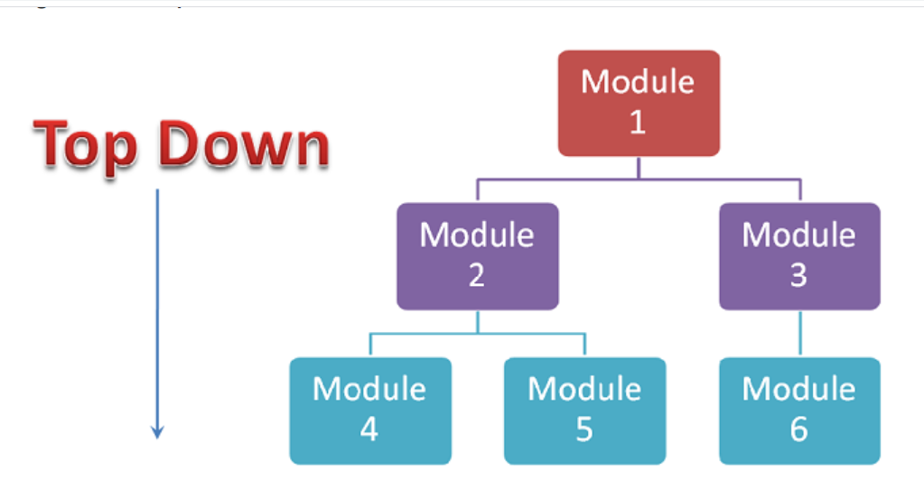

Slide 15
Levels of Testing in V Model
system
requirements
system
integration
Level of abstraction
software
requirements
acceptance
test
preliminary
design
software
integration
test and integrate
detailed
design
component
test
analyze and design
code &
debug
unit
test
Time

Slide 16
Test Plan
The goal of test planning is to establish the list of tasks to be performed
Testing will identify all of the requirements that have not been met in the software.
The main work product is the test plan.
The test plan documents the overall approach to the test. In many ways, the test plan serves as a summary of the test activities that will be performed.
It shows how the tests will be organized, and outlines all of the testers’ needs which must be met in order to properly carry out the test.
The test plan should be inspected by members of the engineering team and senior managers.

Slide 17
Test Planning
A Test Plan:
covers all types and phases of testing.
guides the entire testing process who, why, when, what
developed as requirements, functional specification, and high-level design are developed.
should be done before implementation starts.
A test plan includes:
test objectives
schedule and logistics
test strategies
test cases
procedure
data
expected result
procedures for handling problems

Slide 18
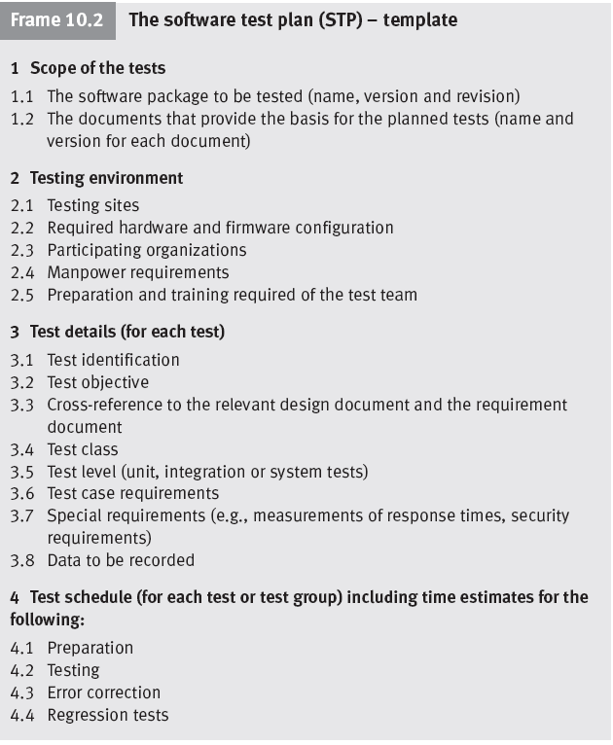

Slide 19
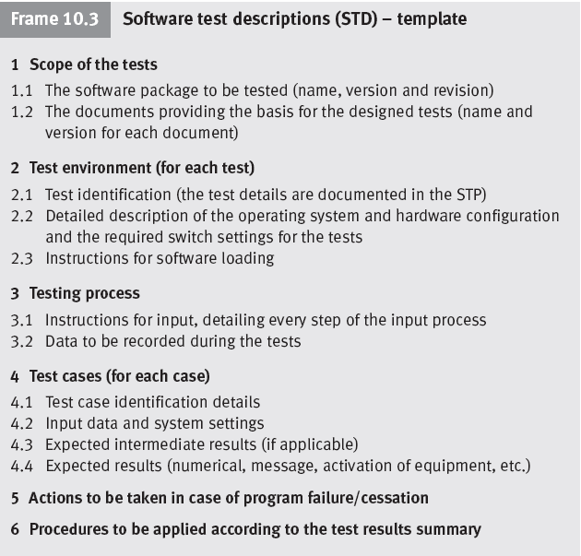

Slide 20
Test Case
What: a set of inputs, execution preconditions and expected outcomes developed for a particular objective, such as exercising a particular program path or verifying compliance with a specific requirement;
Who: QA;
When: (planning)/(design)/coding/testing stage(s);
Why:
Plan test effort / resources / timelines;
Plan / review test coverage;
Track test execution progress;
Track defects;
Track software quality criteria / quality metrics;
Unify Pass/Fail criteria across all testers;
Planned/systematic testing vs Ad-Hoc.

Slide 21
Test Case…
A test case is a description of a specific interaction that a tester will have in order to test a single behavior of the software.
Test cases are very similar to use cases, in that they are step-by-step narratives which define a specific interaction between the user and the software.
A typical test case is laid out in a table, and includes:
ID: unique identifier of a test case, i.e. a unique name and number.
Features to be tested / steps / input values – what you need to do
A requirement which this test case is exercising.
Preconditions which describe the state of the software before the test case (which is often a previous test case that must always be run before the current test case)
Steps that describe the specific steps which make up the interaction
Expected Results / output values -what you are supposed to get from application
which describe the expected state of the software after the test case is executed.
Test cases must be repeatable.

Slide 22
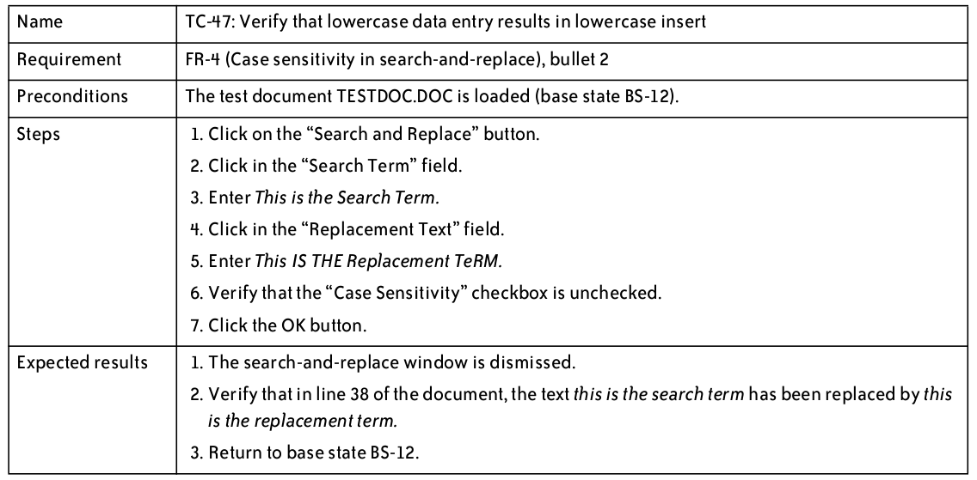
Test Cases – Good Example

Slide 23
Test Suite
A document specifying a sequence of actions for the execution of multiple test cases.
Purpose: to put the test cases into an executable order, although individual test cases may have an internal set of steps or procedures.
Is typically manual, if automated, typically referred to as test script (though manual procedures can also be a type of script).
Multiple Test Suites need to be organized into some sequence – this defines the order in which the test cases or scripts are to be run, what timing considerations are, who should run them etc.

Slide 24
Test Execution
The software testers begin executing the test plan after the programmers deliver the alpha build (partially complete), or a build that they feel is complete.
The alpha should be of high quality—the programmers should feel that it is ready for release, and as good as they can get it.
There are typically several iterations of test execution.
The first iteration focuses on new functionality that has been added since the last round of testing.
A regression test is a test designed to make sure that a change to one area of the software has not caused any other part of the software which had previously passed its tests to stop working.
Regression testing usually involves executing all test cases which have previously been executed.

Slide 25
Defect Tracking
The defect tracking system is a program that testers use to record and track defects. It routes each defect between testers, developers, the project manager and others, following a workflow designed to ensure that the defect is verified and repaired.
Every defect encountered in the test run is recorded and entered into a defect tracking system so that it can be prioritized.
The defect workflow should track the interaction between the testers who find the defect and the programmers who fix it. It should ensure that every defect can be properly prioritized and reviewed by all of the stakeholders to determine whether or not it should be repaired. This process of review and prioritization referred to as triage.

Slide 26
Postmortem Reports
The postmortem report is an overall account of the team’s experience in building the software, and of the experience of the users and stakeholders in working with the team.
The report should contain an honest assessment of how the team members, users, and stakeholders perceived the end product, and assessed the decisions made throughout the project.
The purpose of the post-mortem report is to highlight the team’s successes and identify any problems which should be fixed in future releases.

Slide 27
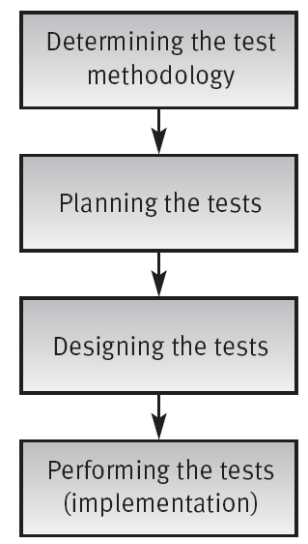
The Testing Process

Slide 28
